Slide 1
Webinar 3: Business Plans
Module 1
Career Analysis and Business
Course content is the exclusive property of the Collège de l’immobilier du Québec and the participant agrees not to redistribute, reproduce or use the material in any way.

Slide 2
Webinar Outline
Introduction to Business Plans
Business Plan Components
Writing a Business Plan
  Step-by-step guide using a case study and templates

Slide 3

Introduction to Business Plans
Give me six hours to chop down a tree and I will spend the first four sharpening the axe.
- Abraham Lincoln

Slide 4
Introduction to Business Plans
Why is it important to write a business plan?

Slide 5

Introduction to Business Plans
The benefits of planning are:
personal
commercial
well-known
social and community-wide
and much more…
A goal is a dream with a deadline.
- Napoleon Hill
Notes:
Making a business plan will provide a framework for your project:
First, it will allow you to see if your expectations are realistic and achievable. It’s better to lose money on paper than to take the plunge and lose everything as a result of poor planning. Don’t think that you’re different or that you’re immune to failure. Real estate brokerage is an extremely competitive field and the retention rate is very low.
Second, writing down your goals and developing an action plan to achieve them is sure to increase your chances of success. Like a road map, it helps you reassess and change course when an obstacle arises so you can arrive at your destination as planned.
Third, “Entreneurship”—with a capital E— is sure to have an impact on your home life. Your business will involve some sacrifices, whether financial or having to miss certain events and your business plan will help you to better communicate your intentions to your loved ones.
Fourth, your consistency and perseverance will be the key drivers of your success. And your success will benefit everyone. You will pay more taxes and spend more money. You may even hire employees.
Without a plan, you might know what you want, but not know how to get it. This is by far the most important step in your journey to date!
Take advantage of this course to actually build a business of your own. It will come in handy when you’re licensed.

Slide 6
Introduction to Business Plans
How to set your goals
S – Specific
M – Measurable
A – Attainable
R – Realistic
T – Time-based
Notes:
While writing your business plan, always keep the following method in mind to make sure your plan is realistic and achievable.
First, your goals must be specific. For example, I want to make five sales, or I want to earn $20,000.
Second, your goals must be measurable. Being your office’s top seller, for example, is not measurable. However, if you know that the current top seller sells 250 houses per year, you can target 260 houses as your sales goal for the year.
Third, your goals must be attainable. For example, if only 20 homes sold in the area where you want to work and you want to sell 30 homes this year in the same area, your goal is unattainable.
Fourth, your goals must be realistic. Based on your experience, ask yourself if you can realistically achieve your goals.
And fifth, your goals must be set in time.
The SMART method helps you develop a business plan that will propel you toward your goal, one success at a time.

Slide 7
Business Plan Components
What should your business plan include?
Company overview – Mission statement and values
Market research
Marketing plan
Operations plan
Financial plan
Notes:
Your business plan must include several components. However, it’s important to keep it as simple as possible since you will ultimately need to “put it into action.”
A complete business plan should take 30–40 hours to complete as it requires some research and a lot of thought. Think about it, you’re “visualizing” the success of your future business! Set aside an hour a day. Break down your approach and take action! It will pay off in the end!
Let’s take some time to go over the various components of a business plan. There’s no need worry at this point. The next few slides will cover the process in detail, step by step.
Company Overview
To start, it’s important to describe your business plan, including your clients, your area of activity, what you sell and your growth plan. It’s also important to explain why clients should buy your products or retain your services. What sets you apart from your competition?
This overview should ideally be as simple as possible. You should also be able to describe your company in a single sentence—your mission statement and values.
Market Research
Market research is a crucial step in your business as it identifies opportunities for success. It tells you if your project is “Attainable”…
To effectively conduct your research, you will need to gather data about your target market, including client demographics and information on competitors, as well as information about the distribution methods you want to use. It’s important to talk to potential clients, suppliers, partners, etc., then analyze the data you’ve gathered.
Good market research generally includes an analysis of the following:
Target territory
Target clientele
Prospective clients
Competitors
Competitive edge
Once your research is complete, you’ll be able to estimate your business’s market share and revenue for the first year of operation, devise a marketing strategy and plan your budget.
Marketing Plan
The marketing plan consolidates the marketing activities for a given period.
To be effective, your plan must be based on the results of prior market research. It must also show in detail how you will reach your target clientele and convince them to buy your product or use your service.
A good marketing plan includes:
The service—its strengths and weaknesses, as well as the opportunities and risks inherent to launch
Your remuneration rate
Your target market
Competitors
Distribution network
Promotion and advertising activities and costs
Budget and forecasts (both financial and with respect to expansion)
Operations Plan
The operations plan helps define your business goals and how you will achieve them. This part of your business plan allows you to organize your marketing plan to a certain extent and confirm that your project is indeed realistic.
Your operations plan should include such day-to-day operational details as physical facilities, governance structure, accountability, material and technical requirements, etc. It can also include a three- to five-year timeline of actions to undertake to achieve your business goals.
You can also include additional details, such as accounting software, the network of resources you can refer to as needed (advertising agency, partners, mentors, etc.), required permits and authorizations, agreements to be entered into and any other information that may apply to your project.
Financial Plan
The financial plan must show the cost of your project and demonstrate its cost effectiveness. This exercise will allow you to determine which financing method is most appropriate for your situation:
Capital contributions (your savings)
Line of credit
Part-time job
Etc.
This plan generally includes an overview of your personal finances, as well as the cost of your project and the amount set aside to finance it (start-up needs and financing sources).
Ideally, it also includes various scenarios (optimistic, pessimistic and probable), a business case and realistic financial statements for a three- to five-year period.
Source: https://www2.gouv.qc.ca/entreprises/portail/quebec/trousse?lang=fr&g=trousse&sg=&t=&e=557954595:3129796225

Slide 8
Writing Your Business Plan
There are four steps to writing your business plan:
Gathering information
Identifying financial and business needs
Establishing the operations plan
Establishing the financial plan
Notes:
There are four steps to writing your business plan:
Step one: Gathering information.
This step allows you to pinpoint the niche (or segment of the market) you want to cultivate. From there, you can evaluate the market that applies to this subset, develop your marketing plan and “shop around” for your agency.
Step two: Let’s talk budget (or spending plan). Your personal budget and your business budget.
Step three: Ask yourself what concrete actions you’ll take to succeed.
And last, step four: Ask yourself how you’ll pay for everything.

Slide 9
Writing Your Business Plan
Methodology:
Explanation
Practical example
Action! Worksheets to complete
Customized business plan
Final version
Notes:
Before we get started, I suggest the following methodology:
I’ll explain each step and follow with a practical example.
The reference documents contain downloadable worksheets that you can use to gather information and ultimately, guide you through the steps of writing your own business plan.
Let’s get started!

Slide 10
Market Research
The indispensable first step in getting the things you want out of life is this: decide what you want.
- Ben Stein
Notes:
The first step in preparing your business plan is to clearly define where your clients will come from.
Unfortunately, this step is often overlooked because we tend to think that if we limit ourselves too much, we will lose business opportunities.
Let’s clarify a few points.

Slide 11
Market Research
Target market
A target market is a defined market segment to which you regularly communicate a particular message.
To develop a regular clientele
To become a leader in your field
To increase your income
To stabilize your income
Notes:
A target market, otherwise referred to as a segment of the market or niche, is a defined subset of the market to which you regularly communicate a particular message.
(Click) The reason you want to define your target market is to:
[read slide]
When you try to please everyone, you dilute your effectiveness.
Of course, I’m not suggesting you turn down business opportunities that come your way, especially in the beginning. Rather, I recommend structuring your marketing efforts using your target market as a guide.

Slide 12
Market Research
Potential target markets:
Sphere of influence
Geographic target (“farming” area)
Professional circles
Specialty markets
  Luxury homes
  Income-producing properties
  Condos
  Commercial
  Etc.
Associative circles
  Sports activities
  Community involvement
  Political groups
  Ethnic groups
  Etc.
Referrals
Notes:
Describe each target market using examples with pros and cons.

Slide 13
Market Research
FSBOs and expired listings
Could be in your target market
Could also be your target market as such
It’s up to you.
Notes:
Properties that are ‘For Sale by Owner’ (or FSBO) and expired, that is, properties that were on the market but didn’t sell, will inevitably be part of your target market.
Of course, as we’ll see in your marketing plan, it’s important to choose the right time to contact them.
However, some brokers treat FSBOs and expired listings as their own target market by basing their entire business model on them.

Slide 14
Market Research
Analyze your market
Five key questions: In the past 12 months:
How many listings have been advertised in your market?
How many sales were carried out?
What was the average sales price?
How many listings expired?
How many brokers work in your market?
Notes:
Once you’ve chosen your segment of the market, narrow it down further so you have between 400 and 600 properties to cultivate. Don’t take on more than you can manage. You want to be consistent.
Answer these five key questions when narrowing down your segment.
Take, for example, an area with 500 doors...
How many listings have been advertised in your market?
How many sales were carried out?
What was the average sales price?
How many listings expired?
How many brokers work in your market?

Slide 15
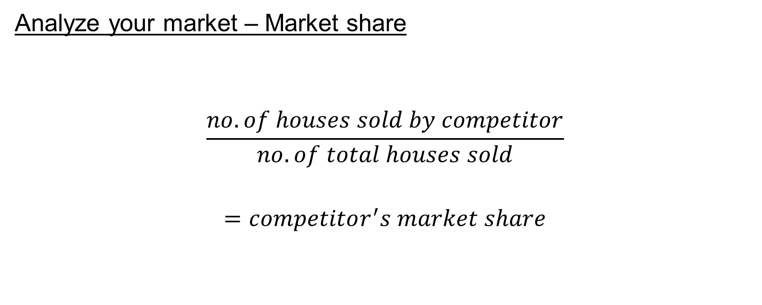
Market Research
Analyze your market – Market share
$$\frac{no. of houses sold by competitor}{no. of total houses sold}$$
$$=competitor^{′}s market share$$
Notes:
Next you’ll need to calculate some ratios from the statistics you obtained.
The first ratio is the market share of each major competitor in your target market.
It’s…

Slide 16
Market Research
Analyze your market – Market share
Example of an area
with 500 doors
Total: 44 sales
Broker A: 6 out of 44 sales
Broker B: 5 out of 44 sales
Broker C: 7 out of 44 sales
Notes:
(Click) Take, for example, a 500-door area with a total of 44 sales last year.
(Click) Broker A had 6 sales, which means they had a 14% market share.
(Click) Broker B had 5 sales, which means they had an 11% market share.
(Click) Broker C had 7 sales, which means they had a 16% market share.
(Click) Other brokers had 59% of the remaining market share.
So in theory, there is still room for a fourth major competitor. However, this area is already quite well cultivated and competition could be fierce since there are already three brokers who are surely working to grow their respective market shares.

Slide 17
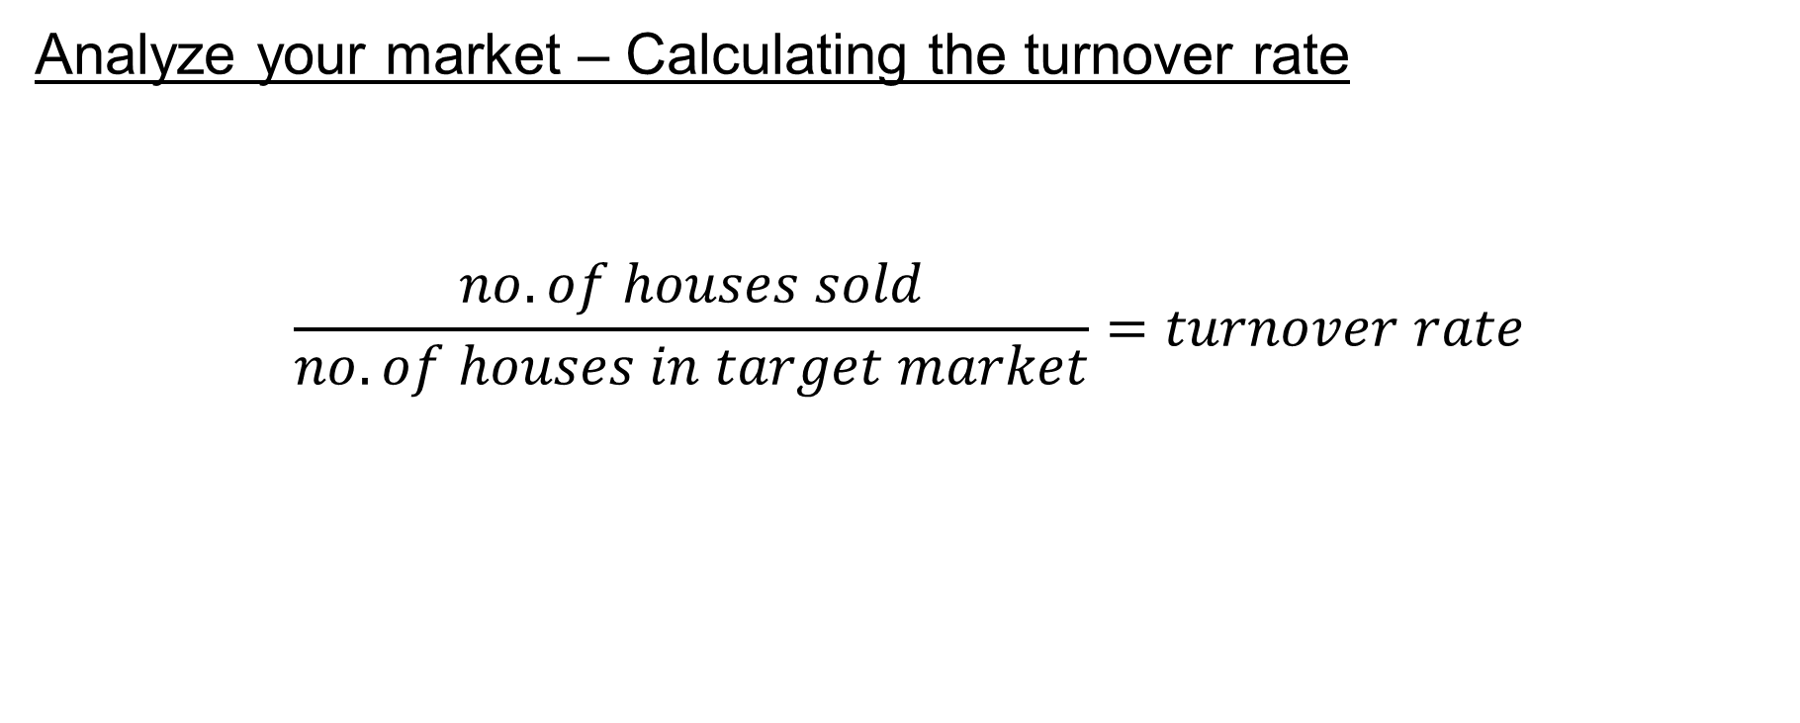
Market Research
Analyze your market – Calculating the turnover rate
$$\frac{no. of houses sold}{no. of houses in target market}=turnover rate$$
44 ÷ 500 = 8.8%
Notes:
Now let’s calculate our second ratio, the turnover rate.
It’s…
It’s therefore the market indicator that tells you if your target market moves a lot. An area where few homes sell will have a low turnover rate.
(Click) Let’s continue with our example. 44 houses sold in your area with 500 doors, which equals a turnover rate of 8.8%.
A turnover rate of 10% or more is ideally what you should be looking for, particularly if the competition is strong. However, if you cultivate such target markets as luxury homes, your turnover rate will inevitably be lower. On the other hand, the remuneration will be higher for each transaction,
so it’s a balancing act.

Slide 18
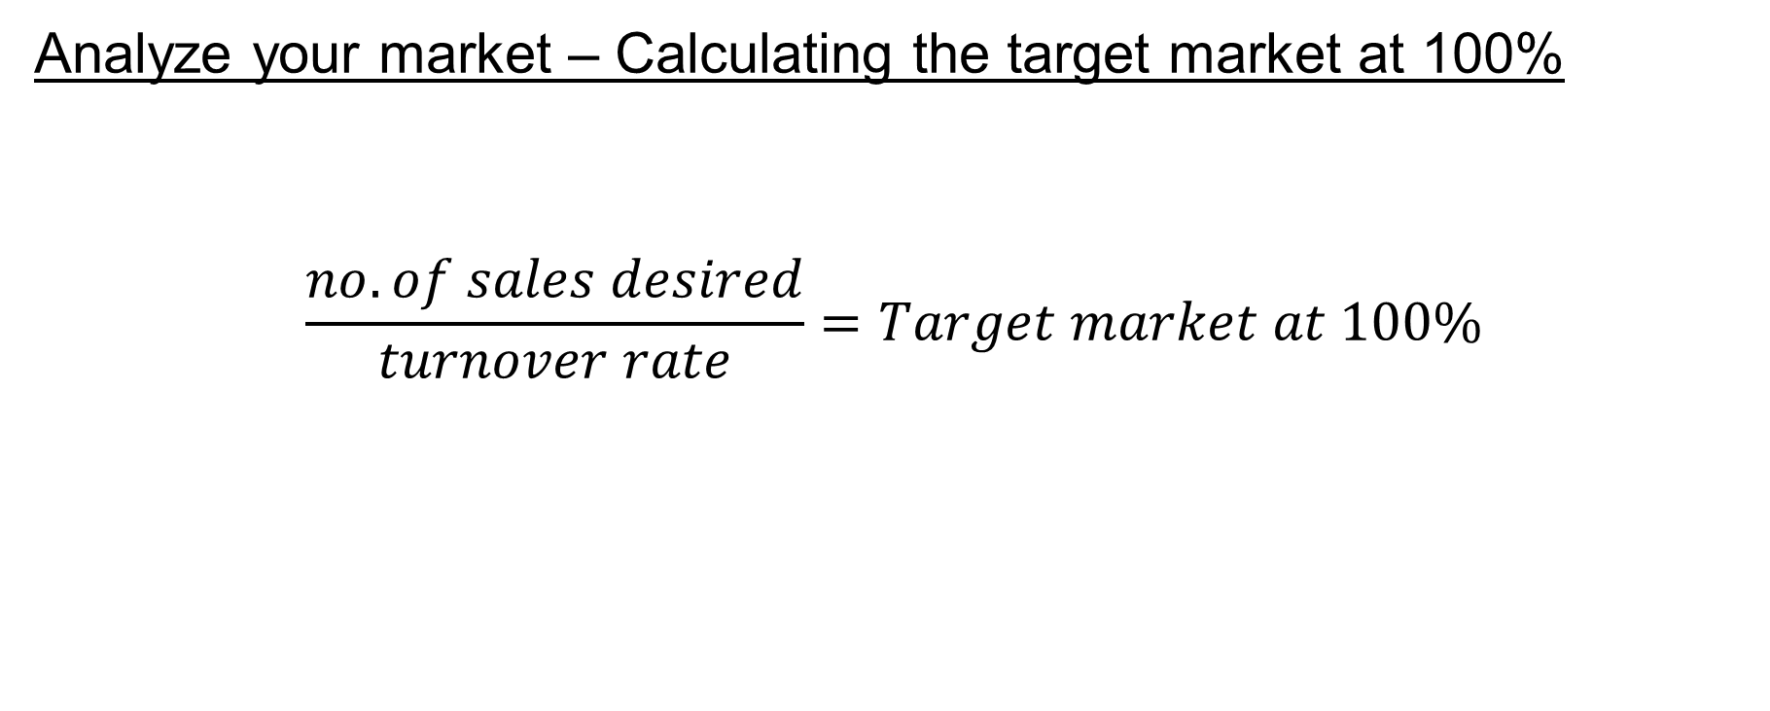
Market Research
Analyze your market – Calculating the target market at 100%
$$\frac{no. of sales desired}{turnover rate}=Target market at 100\%$$
4 ÷ 8.8% = 45 houses
Notes:
Once we have our turnover rate, we can calculate our “market at 100%.”
This ratio will give us the number of homes (or owners) to target if we wanted to theoretically have 100% of the market share.
So for our example, imagine we would like to sell 4 houses in our first year, divided by our 8.8%, equals 45 houses.
Therefore, if we had 100% of the market share, we would theoretically only have to prospect 45 homes to reach our target.
This is clearly unrealistic. We would therefore need to calculate…

Slide 19
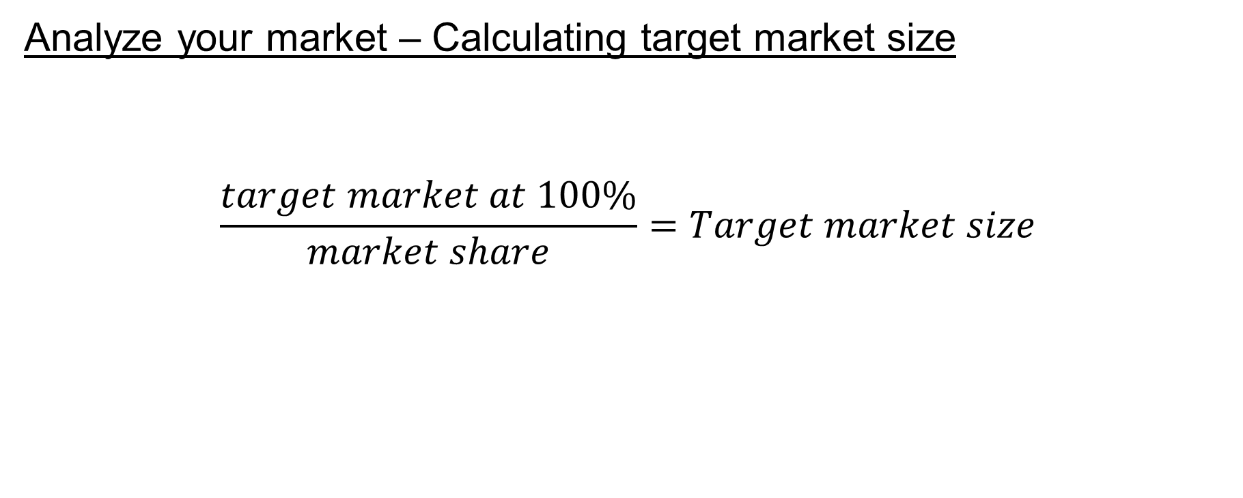
Market Research
Analyze your market – Calculating target market size
$$\frac{target market at 100\%}{market share}=Target market size$$
45 ÷ 5% = 909 houses
Notes:
Target market size. We do this by….
Looking at our example, we know that we need 45 homes, but how can we define OUR market share?
Remember that our competitors…
(click) have 14%, 11% and 16% of the market share, respectively. To be realistic, take the lowest market share and divide it by 2.
That gives us…
(click) 45 houses divided by 5% of the market share, which gives an area of 909 homes (or owners) to regularly and consistently prospect.

Slide 20
Market Research – Conclusion
Reject this farming area unless the average remuneration is very high
  Low turnover rate
  Target market size too large for potential gain
Notes:
Read slide.
Remember that when choosing your area, it’s important to consider that you must always be consistent. If your target market is too broad to start, you could be spreading yourself too thin.
Repeat the exercise with a different target market.
Spending money on paper doesn’t cost a thing.

Slide 21
Market Research – Conclusion
Types of properties and their value
People and their profiles
The competition
Notes:
Other recommendations—when determining your target market, consider:
Read slide.
Is this really the type of property I want to sell?
Are the people I will be serving a “good fit” for me and my personality?
What about the competition? Is it too strong?

Slide 22
Market Research
How do I gather the data for my market research?
Notes:
Now, you must be saying to yourself: “That’s all very interesting, but how am I going to get all these numbers?”
The easiest way is to ask a friend who’s also a broker. As brokers, we have access to all this information.
But you needn’t worry—we’ll cover the process of selecting an agency at the end of this section. During this process you’ll meet the agency executive officer and you can ask them to help you with these numbers.

Slide 23
Market Research—Take Action!
Answer the five key questions
Calculate your ratios using the Excel reference spreadsheet
Choose a target market based on your findings

Slide 24
Marketing Plan
How do I contact
potential clients, and why?
Notes:
Once you’ve identified your target market, you’ll need to plan how to contact your potential clients on a regular basis. This is essentially your marketing plan.
Your marketing plan can be as simple as sending a monthly email to your personal contact list.
You should be aiming for…

Slide 25
Marketing Plan
A system that:
is consistent
stabilizes revenue
eliminates the salesperson’s typical “roller coaster”
Example:
20 listings → 34 transactions
Average remuneration of $6,000
Annual revenue of $204,000
Notes:
Read slide.
(Click) Let’s say, for example, that your area has grown over time and you now have 20 listings.
Averages tell us that one listing normally equates to 1.7 transactions. So your 20 listings become
34 transactions.
At an average of $6,000 per transaction (depending on your sector),
you are potentially looking at stable recurring annual revenue of $204,000.
However, if you rely solely on active prospecting…
[draw troughs on the whiteboard]

Slide 26
Marketing Plan
vs.
Active prospecting
Costs almost nothing
Time consuming
Difficult to delegate
Potential inconsistency
Passive prospecting (marketing)
Expensive
Requires initial investment
Easy to delegate
Consistent and recurring
Notes:
There are two ways of communicating with your target market:
Active prospecting
Explain pros and cons
Passive prospecting (or marketing)
Explain pros and cons
You will be tempted, especially early on, not to invest in marketing to save money.
But this a fundamental error that could cost you your career.
Like any company, you must continually invest and reinvest capital to maintain your “brand reputation.”
Don’t be penny-wise and pound-foolish.

Slide 27
Marketing Plan—Means and Activities
Marketing (passive prospecting)
Advertising
  Pamphlets and direct mail
  Social media
  Magazines and newspapers
Mass emailing
Promotions
Events
Website and blogs
Internet leads
Active prospecting
Networking and trade shows
Door-to-door
Cold calling
Strong presence on social media
  Commenting
  Forums
Notes:
Read and develop with explanations and examples
(Click to show a brief overview of CASL)—Click again to close
Further explanation of cold calling:
It was probably the simplest and most economical means until the National DNCL.
Today, door-to-door is probably the easiest and cheapest means.
There are numerous rules to comply with. (Click to show a brief overview of the National DNCL) —Click again to close
You also need to manage your prospecting list (sort and check if numbers are on the National DNCL and if the property is already listed with another broker, etc.)
Home phones are being used less and less.

Slide 28
Marketing Plan—Means and Activities
National Do Not Call List (DNCL) compliance
You must:
Register with the DNCL administrator and pay the subscription fees
Have an up-to-date call list that excludes numbers registered on the DNCL
Maintain an up-to-date list of consumers who have directly asked to be removed from your list without going through the DNCL
Keep the information used in the course of their activities in case of a complaint
Refrain from soliciting any person whose number is registered on the National DNCL or who has directly asked to be removed from your list
Canada’s Anti-Spam Legislation (CASL) compliance
In short, for each email you send you must:
Have the email holder’s consent (express or implied)
Provide identification information
Have an exclusion mechanism
Marketing (passive prospecting)
Advertising
  Pamphlets and direct mail
  Social media
  Magazines and newspapers
Mass emailing
Promotions
Events
Website and blogs
Internet leads
Active prospecting
Networking and trade shows
Door-to-door
Cold calling
Strong presence on social media
  Commenting
  Forums
Notes:
Read and develop with explanations and examples
(Click to show a brief overview of CASL)—Click again to close
Further explanation of cold calling:
It was probably the simplest and most economical means until the National DNCL.
Today, door-to-door is probably the easiest and cheapest means.
There are numerous rules to comply with. (Click to show brief overview of the National DNCL) —Click again to close
You also need to manage your prospecting list (sort and check if numbers are on the National DNCL and if the property is already listed with another broker, etc.)
Home phones are being used less and less.

Slide 29
Marketing Plan—Means and Activities
Selling is a contact sport!
More contacts = more appointments
6 contacts = your prospective clients start to remember you
9 contacts = your prospective clients know you
12 contacts = your prospective clients think of you
Plan to reach out to your target market at least once a month.
Notes:
Growing your client base is a matter of numbers. More contacts = more appointments.
As you continue to grow, you will need to measure and evaluate your ratios between the cost per contact and number of appointments.
They say that… [read slide and elaborate]

Slide 30
Marketing Plan—Means and Activities
Marketing listings
Signs
Advertising
  Pamphlets and direct mail
  Social media
  Magazines and newspapers
Mass emailing
Centris.ca
Promotions
Open houses
Website and blogs
Internet leads
Notes:
You’ll also need to create your marketing plan for your listings.
The means and activities for advertising your listings are the same as for advertising yourself (with the exception of Centris.ca). This doesn’t mean, however, that you’ll use the same means.
It’s up to you.

Slide 31
Marketing Plan—Means and Activities
The two key questions to ask
How much money do you have for marketing?
How much time do you have for active prospecting?
Notes:
When assessing the various potential means and activities available to you, it’s vital to ask yourself these questions:
AS OF RIGHT NOW:
How much money do I have per month for marketing?
How much time do I have per day/week for active prospecting?
Using the answers to these two questions, develop your marketing plan.

Slide 32
Marketing Plan—Example
I have $500 per month to invest in marketing
My marketing plan over the next 12 months will be:
Month 1:
Create and print door-to-door pamphlets
Months 2–12:
Create one Facebook visual each month myself
Invest $500 in geolocalized Facebook advertising

Slide 33
Marketing Plan—Example
I have 2 hours a day (10 hours a week) for active prospecting.
My prospecting plan over the next 12 months will be:
Spend 30 minutes a day creating stories on Facebook and Instagram and replying to various comments on social media
Depending on the weather, spend 1.5 hours either cold calling or door-to-door prospecting in my area

Slide 34
Marketing Plan—Conclusions
Keep your marketing plan realistic
Make sure your efforts remain consistent
Be specific and keep things as simple as possible

Slide 35
Marketing Plan—Take Action!
Answer the two key questions
Write up your targeted marketing plan

Slide 36
Agency Selection
What will your business model be?
Affiliation with an agency
Single affiliation as a self-employed worker
Carrying your activities within a business corporation
Working in a team
Acting on your own account
Notes:
Your agency will need to reflect your needs.
But first, you need to decide how you want to affiliate.

Slide 37




Business Model
VS.
Single affiliation (self-employed)
Carrying your activities within a business corporation (incorporated)
Agency
Agency
You
Your company
You
Notes:
(Click) When you’re affiliated with an agency as a self-employed worker, all your real estate brokerage income is
(click) personal income that is taxed at a rate according to your level of income.
(Click) When you are affiliated with your agency as an individual practising within a corporation (company),
your agency pays (click) your company.
And you decide the salary you will pay (click) yourself.
Since your company is a completely separate entity from you, it may be interesting if, for example, you decide to start part-time with a good base salary.

Slide 38
Business Model—Examples
Income and taxes before adding self employment revenues
Net income after taxation of both revenues
Income | $80,000
Combined taxes (26%) + QPP | ($24,000)
Net income | $56,000
Income | $80,000
Remuneration received | $30,000
Business expenses | ($10,000)
Total personal income | $100,000
Combined taxes (29%) + QPP | ($32,000)
Net income | $68,000
Notes:
Explain and conclude that $20,000 of additional net income actually only equates to $12,000 net ($68,000 - $56,000).

Slide 39
Business Model—Examples
Income and taxes before adding your revenues
Company net income after tax
Income | $80,000
Combined taxes (26%) + QPP | ($24,000)
Net income | $56,000
Company revenue | $30,000
Business expenses | ($10,000)
Total company revenue | $20,000
Combined taxes (26.7%) | ($5,340)
Net income | $14,660
Notes:
Explain and conclude that for the same $20,000 of additional net income, your net income is now $14,660, or $2,660 more.
This is, of course, theoretical and should take into account the additional costs of accounting and other business administration costs
It is important to keep all company revenue INSIDE the company.
Other decision-making factors may also need to be accounted for, such as family allowances and the like.
Getting a good accountant to conduct a thorough tax assessment will help you make the right decision.

Slide 40
Business Model—Working In A Team
2 typical models:
One or more experienced broker(s) listing
  One or more broker(s) who work with buyers
    The buying broker pays a referral fee for each transaction to the lead broker
Co-listing
  Two or three brokers are equal partners and split up the various tasks—sellers and buyers together
Notes:
Read and explain with examples.

Slide 41
Business Model—Working as a Team
Pros
Learning more about the profession
Less pressure to generate clientele
Better time management
A “guaranteed” income of sorts
Cons
Limited independence
Working in the shadow of another broker
Diluted income
Notes:
Read and explain with examples.

Slide 42
Business Model—Working In A Team
Comments:
Working as a team doesn’t mean you can’t incorporate (Carrying your activities within a business corporation).
If you decide to work as a team, the agency will form by itself.
Make sure you have clear understanding of all the costs and the remuneration sharing agreements.
Don’t be shy to “shop around” for teams.
Notes:
Read and explain with examples.

Slide 43
Business Model—Acting on your own account
Criteria:
The legal form is limited to a natural person only (you cannot incorporate yourself).
You must act under your own name.
You cannot hire other brokers to work for you.
You must keep all your records and registers (like an agency).
You must have a trust account.
Notes:
Working for yourself is a separate category.
Read the criteria.
In short, you are like an agency with all the administrative burden but without the tax breaks (incorporation) and financial benefits (recruiting brokers).
This type of business model is typically of interest to retiring brokers. They can collect their referral income with reduced costs since they are not affiliated with an agency.

Slide 44
Agency Selection
Questions to ask:
Fees
Services included and not included
Training
Support and mentoring
Notes:
Once you’ve identified your business model (other than as a team) and established your target market, you’ll be able to “shop around” for your agency.
You can divide your questions into four broad categories:
Fees
Services included and not included
Training
Support and mentoring

Slide 45
Agency Selection
Fees
Monthly payments
Remuneration sharing or transaction fees
E.g.: $800/month
E.g.: 5% per transaction
Notes:
Basic principles:
(Click) The higher the monthly fees (e.g., $800/month),
(Click) the lower the remuneration sharing should be (e.g., 5% per transaction).
Versus

Slide 46
Agency Selection
Fees
Monthly payments
Remuneration sharing or transaction fees
E.g.: $100/month
E.g.: 30% per transaction
Notes:
Basic principles:
(Click) The higher the monthly fees (e.g., $100 per month),
(Click) the lower the remuneration sharing should be (e.g. 30% per transaction).

Slide 47
Agency Selection
Example of a comparative table of annual fees:
 | $30,000 | $60,000 | $90,000 | $120,000
Plan A ($100/month + 30%) | $9,120 | $19,200 | $28,200 | $37,200
Plan B ($400/month + 15%) | $5,300 | $13,800 | $18,300 | $22,800
Plan C ($800/month + 5%) | $11,100 | $12,600 | $14,100 | $15,600
Notes:
To properly assess each agency’s service offerings, create a comparison table by revenue level:
It’s clear in this comparison table example that despite the higher monthly payment for Plan B, the offer is much more attractive to a junior broker.

Slide 48
Agency Selection
Service and tools included
Do you offer these services and at what price (are they included or not)?
Website
Productivity suite (Google Suite, email address, etc.)
Bulk email solutions
Cold calling solutions
  Subscription to the National DNCL
  Telelisting
  Internal list of excluded numbers
If not, do you have business agreements with third-party partners?
Do you offer any other services?
Notes:
Ask the following questions and adapt your questions to your target market and marketing plan.

Slide 49
Agency Selection
Training
Is there specific training for entry-level brokers?
What other training is available?
  Upon request or at the office
Is there a game plan established for training or is it based on ad hoc needs?
Watch out for prospecting seminars disguised as “training”

Slide 50
Agency Selection
Mentoring and support
Is there a mentoring system already in place at the agency?
Who will you turn to if you have questions?
  General questions
  Last-minute questions in the field
Be practical. Imagine you’re out in the field tomorrow morning. What will you need?

Slide 51
Agency Selection—Take Action!
Consult an accountant and establish your business model
  Incorporated or self-employed
  Team or no team
Shop for agencies based on your target market, marketing plan and your needs as a junior broker
  Ask all your questions

Slide 52
Writing Your Business Plan
There are four steps to writing your business plan:
Gathering information
Identifying financial and business needs
Establishing the operations plan
Establishing the financial plan
Notes:
We have just completed the longest and most important step—gathering information.
Congratulations!

Slide 53
Business Plan Components
What should your business plan include?
Company overview – Mission statement and values
Market research
Marketing plan
Operations plan
Financial plan
Notes:
You have completed your
market research
and
your marketing plan
To establish your operations and finance plan, you must now move on to step 2, which is…

Slide 54
Writing Your Business Plan
There are four steps to writing your business plan:
Gathering information
Identifying financial and business needs
Establishing the operations plan
Establishing the financial plan
Notes:
Identifying financial and business needs
Continue this work using …

Slide 55
Move on to Module 2!

